Slide 1
PROJECT TITLE :Secure Data Hiding in Images Using Steganography
CAPSTONE PROJECT
Presented By:
Student Name : Anurag Ugargol
College Name & Department : KLS Gogte Institute Of Technology

Slide 2
OUTLINE
Problem Statement
Technology used
Wow factor
End users
Result
Conclusion
Git-hub Link
Future scope

Slide 3
Problem Statement
With the rise in cyber threats, secure communication is crucial.
Traditional encryption methods can attract hackers' attention.
Steganography provides a hidden layer of security by embedding data in images.
This project aims to develop a secure method for hiding sensitive information within images to prevent unauthorized access.

Slide 4
Technology used
Programming Language: Python
Libraries Used: OpenCV, Pillow
Encryption Method: LSB (Least Significant Bit) Steganography
Platform: Windows

Slide 5
Wow factors
Uses LSB technique for secure data embedding in images.
Can hide text or even small files within images.
Encrypted data is nearly undetectable without the extraction key.
Works with different image formats like PNG, BMP, and JPG.
Protects sensitive information without raising suspicion.

Slide 6
End users
Cybersecurity professionals
Government agencies for secure communication
Journalists and whistleblowers for confidential data transmission
Businesses for protecting proprietary information
Individuals looking for secure personal data storage

Slide 7
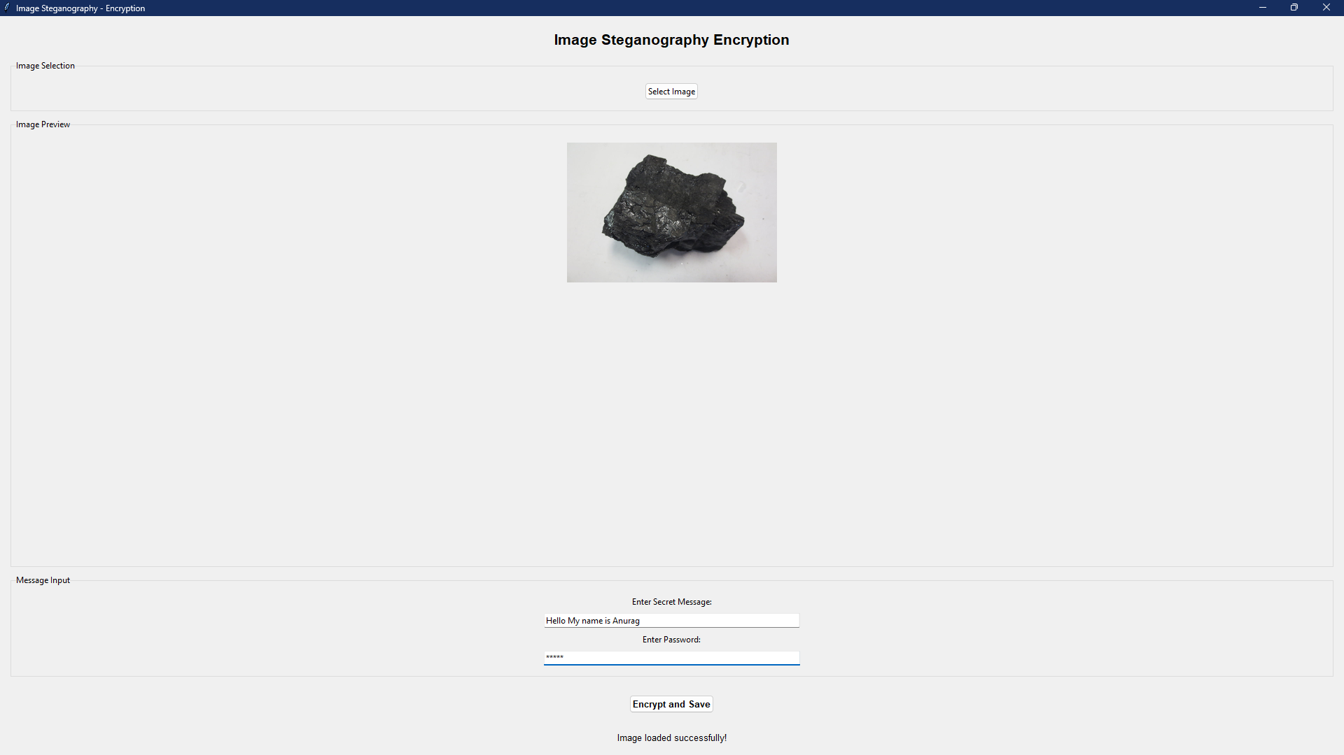
Results
Encryption GUI

Slide 8

Results
Encrypted Image

Slide 9
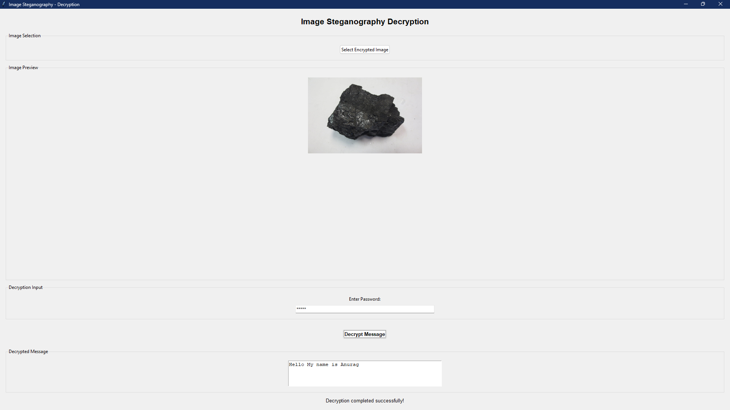
Results
Decryption GUI

Slide 10
Conclusion
Steganography enhances data security by hiding information in images.
It provides an additional layer of security beyond encryption methods.
The project successfully implements data hiding and extraction with high accuracy.
Future improvements can include multi-layer encryption and AI-based detection prevention.

Slide 11
GitHub Link
https://github.com/AnuragU03/AICTE-Project.git

Slide 12
Future scope(optional)
Enhancing security by integrating AES or RSA encryption before embedding.
Developing an AI-based steganalysis detection evasion system.
Implementing video or audio steganography.
Making a user-friendly GUI for non-technical users.

Slide 13
THANK YOU

